Slide 1
Share Point 2007
Today companies are using Web sites not just to reach customers, but also to provide applications for vendors, employees, and top-level management. It’s not uncommon for a large company to create hundreds or even thousands of Web sites. For example, a large corporation could require a new Web site to be created for each new marketing campaign or each new employee.
In a world without SharePoint products and technologies, it can be expensive and time consuming for a company to keep up with its need to continually create and manage Web sites
To get a new Web site up and running usually takes weeks, or sometimes even months, because of the need to coordinate efforts between a database administrator, a Web developer, and a system administrator.
Windows SharePoint Services (WSS) was designed from the ground up to make the creation of Web sites faster and more cost effective. As a WSS developer, you will learn to develop components that others will use to create sites and workspaces.

Slide 2
Share Point 2007
At its core, WSS is a site provisioning engine. The architecture of WSS was specifically designed to operate in a Web farm environment. The act of provisioning (a fancy word for creating) a site in WSS can be accomplished by any member of the IT department in less than a minute by filling in the required information in a browser-based form and clicking the OK button. There’s no need for a database administrator to create a new database or any new tables. There’s no need for an ASP.NET developer to create a new ASP.NET Web site. There’s no need for a system administrator to copy any files or configure any IIS settings on the front-end Web server.
The WSS site provisioning engine is based on an integrated storage model that involves multiple SQL Server databases to store content and configuration data. When you install WSS, you can elect to use SQL Server 2005 or SQL Server 2000. For simple deployments and development scenarios, you can also use SQL Express, which eliminates the need to purchase a licensed copy of SQL Server.

Slide 3
Microsoft Office SharePoint Server 2007 :
It is important that you know the difference between Windows SharePoint Services (WSS) and Microsoft Office SharePoint Server 2007 (MOSS). While WSS and MOSS are both pieces of software built by the Microsoft Office team, WSS is included as a part of the Windows Server 2003 operating system while MOSS is a separate product with its own. You should think of WSS as the underlying platform and think of MOSS as a value-added set of components and services that has been built on top of this platform.
WSS does not have its own licensing model. Instead, the use of WSS is controlled through Windows Server 2003 licenses. This makes it very cost effective for companies to roll out applications that have been designed and built on top of the WSS platform. MOSS, on the other hand, has its own licensing model that includes server-side licenses and client access licenses (CALs).

Slide 4
Share Point Portal
A portal is a single point of entry for a family of web sites. Often these sites have complex relationships, such as multiple tree structures or a complicated grid or a network topology.
Portal takes care of complex tasks such as user login, authentication , authorization and personalization.
Portal provides common user interface artifacts such as master pages and themes giving the underlying sites a common appearance that can be easily personalized to suit each user’s tastes.

Slide 5
What is share point?
The business collaboration platform for the enterprise and the web
Allows individuals in an organization to easily create and manage their own collaborative Web sites
Simplifies how people find and share information across boundaries, and enabling better informed decisions
Seamlessly integrates with Windows and MS Office
Does not refer to a specific product or technology
Using the word “Microsoft SharePoint” is like using the word “Microsoft Office”
Refers to several aspects of Web-based collaborative solutions

Slide 6
Why Share Point?
Easily Create a Collaborative Site
  Technical skill requirement is minimal
    Microsoft Windows
    Microsoft Office
    Familiar with web browsing
Easily define relevant access
  Based on communication needs
  If deployed appropriately, it does not have to deal with Updating content,
  Defining account privileges, Maintaining a document repository
Efficiently Manage Information
  SharePoint provides various tools to effectively centralize and manage information : Schedule, Documents, Change Request ,Risk/Issue Log

Slide 7
Share Point Components
Share point is a three tiered application. Presentation layer lives in the file system as an ASP.NET application, logic lives in .NET assemblies and the data resides in a SQL server database.
On the surface, Widows Share Point services is a web application that provides a collection of services accessed through share point web pages, XML web services and a .NET application programming interface (API).
Share points core functionality is provided by an infrastructure of .NET assemblies and Windows Services.
Share point stores all content and configuration in SQL Server database. These databases contain stored procedures and other potential points of interaction.

Slide 8
Share Point Lists and Libraries
Share point is made up of content and data. The content in share point is the user interface and information stored in web parts, while data is the information that sharepoint stores in the database.
The lists and libraries of sharepoint are the core to store data in sharepoint.
Lists and libraries are web pages in Windows Services SharePoint 2007 where information can be stored and organized.
A list can be understood as a set of data that lists information that is helpful to users. Lists can be set up or customized by a site designer or authorized user to contain any number of fields required for list data. These contain data elements that define what data is contained in sharepoint. Eg : List of links, a list of announcements etc.
A library is where a collection of files as well as associated data can be stored and managed. They are special type of list that has built-in capabilities to handle storing files. This includes version and new file template features.

Slide 9
Share Point Site
First, a WSS site is a storage container for content. Site content is primarily stored in the form of lists, document libraries, and child sites. Second, a site is a securable entity whose content is accessible to a configurable set of users. A site can either define its own set of users, or it can inherit the users of its parent site. A site also contains a configurable set of groups and permissions that define the level of accessibility that various users have on the site’s lists and document libraries.
Note that WSS doesn’t actually perform user authentication. Instead, WSS relies on the underlying layers within IIS and the ASP.NET authentication provider infrastructure to accomplish that. WSS 3.0 also introduces valuable security trimming features so that commands and links to site elements are only shown to users who are authorized to access them.
Third, a site is an application with an extensible, fully customizable user interface. A site administrator can create pages and customize their layout and appearance. A site administrator can also modify a site’s navigation structure using the browser.

Slide 10
Share Point Site
A site is the foundation for using the Microsoft Web Part Page and Web Part technology. Site administrators can customize Web Part Pages by adding and configuring Web Parts. A user can further personalize a Web Part Page by modifying, adding, and/or removing Web Parts. All the customization data and personalization data associated with the Web Parts on a Web Part Page are automatically stored in the content database.
A site cannot exist as an independent entity within a Web application. Instead, every WSS site must also be created inside the scope of a site collection. A site collection is a container of WSS sites. Each site collection requires a top-level site. In addition to the required top-level site, a site collection can contain a hierarchy of child sites. The first site collection contains just a top-level site. The second site collection contains one level of child sites below the top-level site. The third site collection contains a more complex hierarchy of child sites.

Slide 11
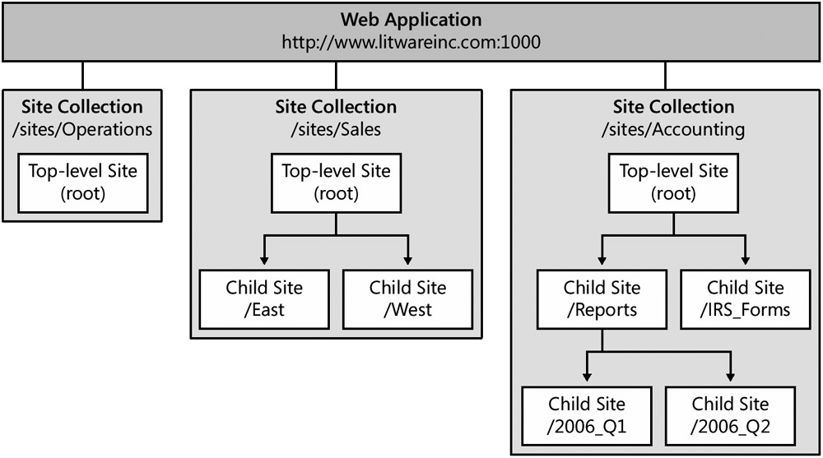
Share Point Site

Slide 12
Share Point WebParts
The primary task of the SharePoint developer is to build reusable components for business users. Business users in turn will take these components and build applications, customizing the application for the particular business need and personalizing the application for their own working style. This development mindset is in contrast to typical Windows or Web software that is deployed as a complete unit. With WSS technologies, the application is always evolving as business users employ deployed components to build their own applications and workspaces. Web Parts are used within the site to enable further collaboration or integration within the site context.
Web Parts are the fundamental building blocks for SharePoint’s user interface, and with them we can build and integrate many different types of applications. The built-in Web Parts serve as good design examples when writing your own. For example, the Data View Web Part can be configured to point at any data source and display the data in many different ways. In the same way, all of the Web Parts that ship with WSS are generic and built for reuse. Although you may build more specific applications with Web Parts, it is important to be as generic as possible to allow the greatest flexibility for your customer, the business user, who can then configure the Web Part for a specific use.

Slide 13
Share Point Content Types
Content types are a powerful new enhancement introduced in WSS 3.0. The central idea is that a content type defines the underlying schema for either an item in a list or a document in a document library. However, it’s important to understand that content types are defined independently outside the scope of any list or document library. After you have created a content type, you can use it across several different lists or several different document libraries.
For example, imagine you create a content type named Company that defines a set of columns for tracking information about a company. After creating this content type you could then create two different lists named Vendors and Customers and configure both of these lists to use the Company content type. This gives you something akin to polymorphism, because you have two different list types that contain homogeneous items that are defined by the same schema.

Slide 14
Share Point Content Types
Content types also provide you with the ability to maintain heterogeneous content inside a single list or document library. For example, you can configure a single list to support multiple content types. Imagine a business scenario in which you need to track customers, and those customers may be either companies or individuals. The problem you face is that customers that are companies and customers who are individuals require different columns to track their information. The solution is to create two different content types for each type of customer and then to create a Customers list and configure it to support both content types.
Content types are defined based upon the principles of inheritance. You will never create a content type from scratch. Instead, you always select an existing content type to serve as the base content type for the new content type you are creating. For example, you can create the most straightforward content type by inheriting from the built-in WSS content type named Item. This automatically provides your new content type with the standard columns and behavior that are common across all content types. Alternatively, you can elect to inherit from one of the more complex built-in content types that inherit from the Item content type, such as Announcement, Task, or Document.

Slide 15
User Access Management and Personalization
One of the compelling reasons for using the SharePoint platform as a basis for your intranet and extranet web applications is its built-in security model. This model provides a rich set of tools for securing objects (web applications, site collections, sites, lists, folders, and items) and assigning permissions on those objects to users.
This group of services focuses on automating tasks around users and user permissions. You will be able to add users, groups, and roles by using both the object model and web services
It’s often useful to know who has access to a site. You might need to produce a report showing who has access across multiple sites, or might want a count of users in each site group on a site—and the ability to obtain this information is a huge benefit in any company subject to legal or industrial compliance requirements. Of course the built-in SharePoint UI can help with this, but if you’re managing a large number of sites, going to each site’s user administration page to tally or list users can be tedious to say the least.

